Slide 1

SMART BITE
MUHAMMED FAZIL C
MES24MCA-2032
Department of Computer Applications
MES College of Engineering, Kuttippuram
<DATE OF PRESENTATION>

Slide 2
PRODUCT OWNER MS. FEBIN AZIZ ASSISTANT PROFESSOR DEPARTMENT OF COMPUTER APPLICATIONS MES COLLEGE OF ENGINEERING, KUTTIPPURAM

Slide 3
TABLE OF CONTENTS
Introduction
Objective
Existing System
Proposed System
Motivation
Functionalities
Module Description
Developing Environment
Sprint Backlog
Product Backlog
User Story
Project Plans
Data Flow Diagrams
ER Diagram

Slide 4
Smart Bite – AI Powered Personalized Meal Recommendation System
Web-based platform for personalized healthy meal planning.
Uses user profile data (age, gender, height, weight, activity level, goal).
Calculates BMI & TDEE for accurate calorie intake.
Employs a Hybrid Recommendation Engine (Rule-based + AI).

Slide 5
Smart Bite – AI Powered Personalized Meal Recommendation System
Generates balanced meal plans to support weight loss, gain, or maintenance
AI-based recommendations for dynamic personalization.
Grocery list generation with CSV export option.
Progress tracking using charts & visual reports.
5

Slide 6
OBJECTIVES
To simplify healthy eating through an intelligent meal planning system.
To integrate AI recommendations with rule-based reliability.
To offer diet customization based on lifestyle, preferences, and health goals.
To generate nutritionally balanced meals for weight loss, gain, or maintenance.
To provide interactive support via chatbot and optional voice assistant.
To enhance user motivation with progress visualization and reports.

Slide 7
EXISTING SYSTEM
Fitness and diet apps like MyFitnessPal, HealthifyMe, and Cronometer are available.
They help with calorie tracking and basic meal planning.
Lack of hybrid recommendation (rule-based + AI).
Limited personalization for cultural food preferences.
Closed design – not easily extensible or customizable.
with

Slide 8
PROPOSED SYSTEM
A web-based platform for personalized meal planning.
Combines Rule-based algorithms with AI-powered recommendations.
Calculates BMI & TDEE to set accurate calorie goals.
Provides daily/weekly meal plans based on user profile.
Generates grocery lists for shopping convenience.
Offers progress tracking with charts and reports.
Designed with open and extensible architecture for future modules.

Slide 9
MOTIVATIONS
Growing awareness of healthy lifestyle and fitness
People face difficulty in planning balanced diets on their own.
Existing apps are expensive or limited in free features.
Lack of personalization for local food preferences.
Need for an easy-to-use, AI-powered, and extensible system
Desire to integrate diet planning with grocery management & progress tracking.

Slide 10
FUNCTIONALITIES
User Authentication – Secure login and registration.
Profile Setup – Collects age, weight, height, gender, and activity level.
Calorie Calculation – Uses BMR & TDEE algorithms to set daily goals.
Hybrid Recommendation Engine – Combines rule-based filtering with AI suggestions.

Slide 11
FUNCTIONALITIES
Meal Planning – Creates daily/weekly balanced diet plans.
Grocery List Generator – Converts meal plan into a shopping list, exportable in CSV.
Progress Tracking – Charts and reports to monitor calorie intake & goal achievement.

Slide 12
MODULE DESCRIPTION
User Authentication Module Handles login/registration, password security, and user management.
Profile Management Module Stores user details (age, weight, height, activity level, dietary goals).
Calorie & BMI Calculation Module Uses BMR and TDEE algorithms to calculate daily calorie needs.
Recommendation Engine Module Hybrid system combining rule-based filtering with AI-generated meal plans.

Slide 13
MODULE DESCRIPTION
Meal Planner Module Creates daily/weekly balanced diet plans from the food dataset.
Grocery List Generator Module Automatically generates shopping lists with CSV export.
Progress Tracking Module Uses Chart.js/Matplotlib to display calorie intake, nutrition balance, and progress reports.

Slide 14
DEVELOPING ENVIRONMENT
Operating System: Windows 11
Front End: React.js (JavaScript, HTML5, CSS3)
Back End: Django (Python Web Framework)
Database: SQLite
Frameworks & Libraries:
Django REST Framework (API)
Pandas, NumPy (data handling)
Matplotlib / Chart.js (visualization)
AI API: OpenAI API (for meal suggestions)
IDE / Tools: VS Code
Version control: GitHub
``

Slide 15
SPRINT BACKLOG
Backlog tem | Status And Completion Date | Original Estimation in Hours | Day 1 hrs | Day 2 hrs | Day 3 hrs | Day 4 hrs | Day 5 hrs | Day 6 hrs | Day 7 hrs | Day 8 hrs | Day 9 hrs | Day 10 hrs
SPRINT1
Database design | 16/8/2022 | 3 | 1 | 1 | 1 | 0 | 0 | 0 | 0 | 0 | 0 | 0
Basic UI design | 22/8/2022 | 4 | 1 | 1 | 1 | 1 | 0 | 0 | 0 | 0 | 0 | 0
Django setup | 27/8/2022 | 3 | 1 | 1 | 1 | 0 | 0 | 0 | 0 | 0 | 0 | 0
SPRINT 2
User Profile Module | 13/9/2022 | 5 | 1 | 1 | 1 | 1 | 1 | 0 | 0 | 0 | 0 | 0
Calorie & Nutrition Calc | 29/9/2022 | 6 | 1 | 1 | 1 | 1 | 1 | 1 | 0 | 0 | 0 | 0
Recommendation Engine |  | 7 | 1 | 1 | 1 | 1 | 1 | 1 | 1 | 0 | 0 | 0

Slide 16
SPRINT BACKLOG
Backlog tem | Status And Completion Date | Original Estimation in Hours | Day 1 hrs | Day 2 hrs | Day 3 hrs | Day 4 hrs | Day 5 hrs | Day 6 hrs | Day 7 hrs | Day 8 hrs | Day 9 hrs | Day 10 hrs
SPRINT3
Weekly Meal Planner | 15/10/2022 | 6 | 1 | 1 | 1 | 1 | 1 | 1 | 0 | 0 | 0 | 0
Grocery List Export | 20/10/2022 | 4 | 1 | 1 | 1 | 1 | 0 | 0 | 0 | 0 | 0 | 0
SPRINT 4
Progress Tracking | 8/11/2022 | 6 | 1 | 1 | 1 | 1 | 1 | 1 | 0 | 0 | 0 | 0
Testing | 15/11/2022 | 6 | 1 | 1 | 1 | 1 | 1 | 1 | 0 | 0 | 0 | 0
TOTAL |  | 50 | 10 | 10 | 10 | 8 | 6 | 5 | 1

Slide 17
PRODUCT BACKLOG
ID | NAME | PRIORITY <high/medium/low> | ESTIMATE (Hours) | STATUS <Planned/In progress/Completed>
1 | REGISTRATION AND LOGIN | HIGH | 8 | IN PROGRESS
2 | HEALTH PROFILE SETUP | HIGH | 10 | IN PROGRESS
3 | MEAL RECOMMENDATION ENGINE | HIGH | 20 | IN PROGRESS
4 | GROCERY LIST GENERATION | LOW | 12 | PLANNED
5 | PROGRESS TRACKING | MEDIUM | 15 | PLANNED

Slide 18
USER STORY
User Story ID | As a type of User | I want to <Perform some task> | So that i can <Achieve Some Goal>
1 | USER | Register | Create an account and start using the system
2 | USER | Login | Securely access my personalized dashboard
3 | USER | Update Profile (age, goals, restrictions) | Receive tailored meal recommendations
4 | USER | Receive Daily/Weekly Meal Recommendations | Know what meals to eat based on my goals
5 | USER | Track Nutritional Intake | Stay within calorie and nutrient goals

Slide 19
USER STORY
User Story ID | As a type of User | I want to <Perform some task> | So that i can <Achieve Some Goal>
6 | USER | Track Progress (weight, BMI, calories burned) | Monitor my health improvements
7 | USER | Generate Grocery List | Easily buy ingredients for my meals
8 | USER | View Meal & Progress History | Track how my diet and health evolved
9 | USER | Receive Daily/Weekly Meal Recommendations | Know what meals to eat based on my goals
10 | USER | Search for Foods/Meals | Check nutrition details of specific items
``

Slide 20
PROJECT PLAN
User StoryID | Task Name | Start Date | End Date | Days | Status
1 | Sprint 1 | 20/08/2025 | 23/08/2025 | 12 | In Progress
2 |  | 24/08/2025 | 27/08/2025 |  | In Progress
3 |  | 28/08/2022 | 01/08/2022 |  | In Progress
4 | Sprint 2 | 02/09/2022 | 07/09/2022 | 17 | In Progress
5 |  | 08/09/2022 | 10/09/2022 |  | In Progress
6 |  | 11/09/2022 | 13/09/2022 |  | In Progress

Slide 21
PROJECT PLAN
User StoryID | Task Name | Start Date | End Date | Days | Status
7 | SPRINT 3 | 14/09/2022 | 18/09/2022 | 14 | In Progress
8 |  | 19/09/2022 | 24/09/2022 |  | In Progress
9 | SPRINT 4 | 29/09/2022 | 03/10/2022 | 10 | In Progress
10 |  | 04/10/2025 | 09/10/2025 |  | In Progress

Slide 22
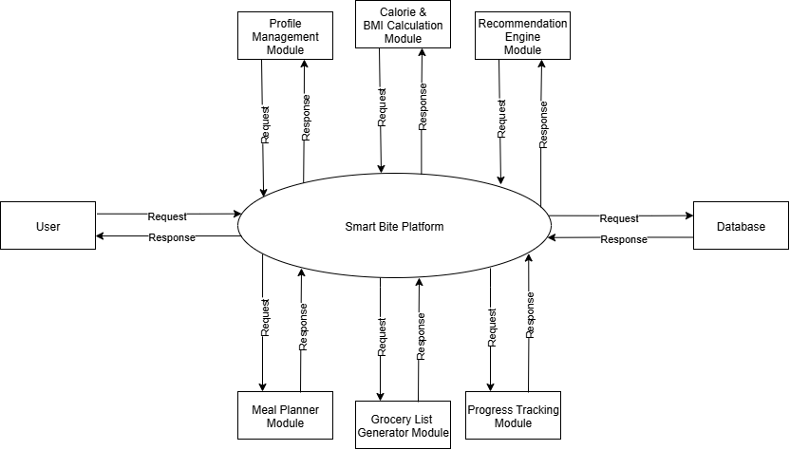
DATA FLOW DIAGRAM
LEVEL 0

Slide 23
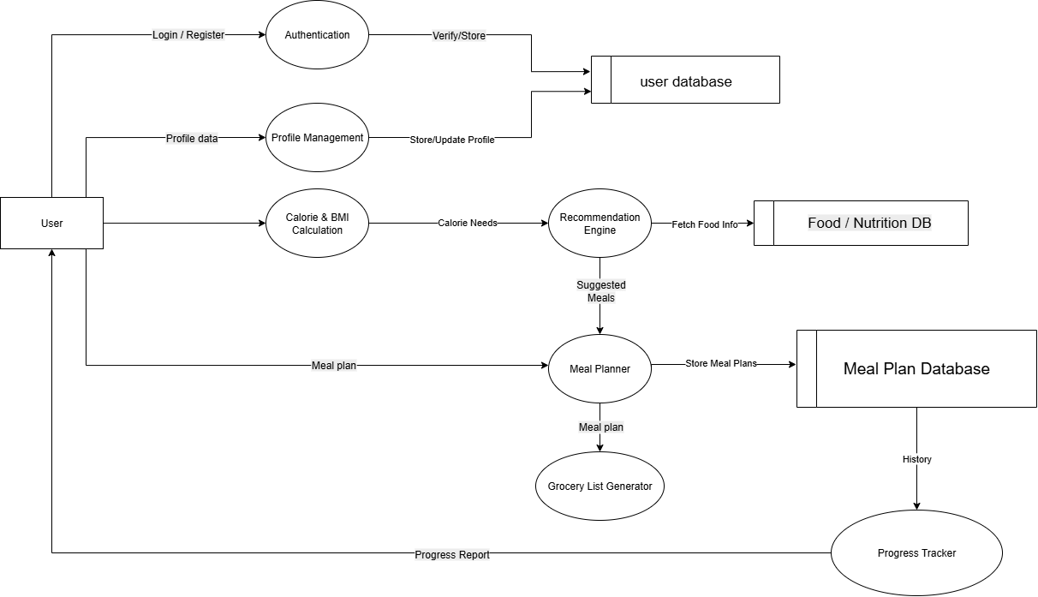
DATA FLOW DIAGRAM
Level 1

Slide 24
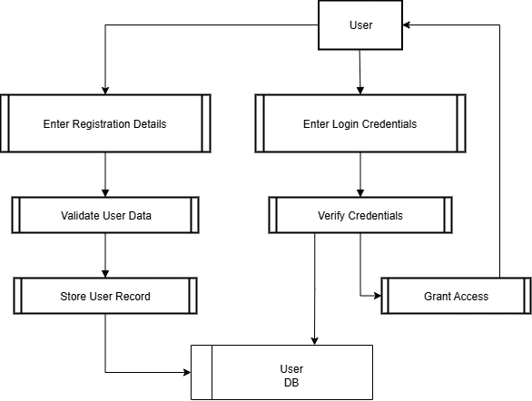
DATA FLOW DIAGRAM
Level 2.1

Slide 25
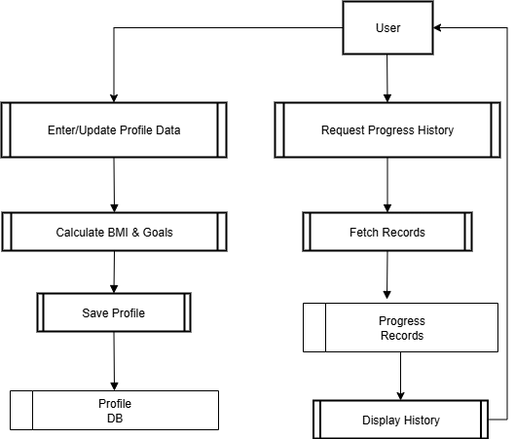

DATA FLOW DIAGRAM
Level 2.2

Slide 26
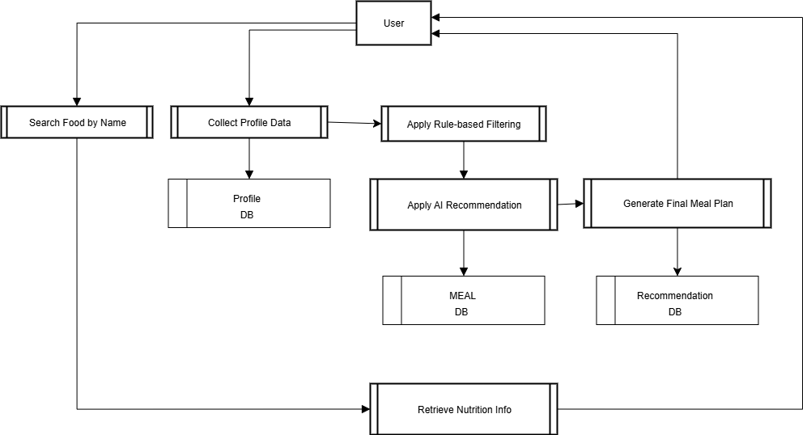
DATA FLOW DIAGRAM
Level 2.3

Slide 27
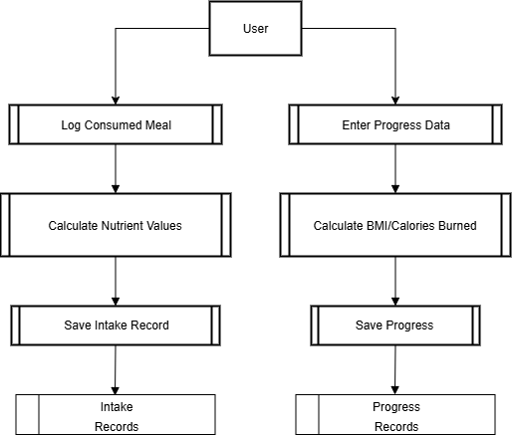
DATA FLOW DIAGRAM
Level 2.4

Slide 28
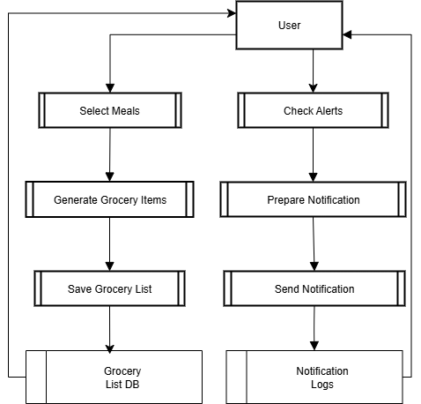
DATA FLOW DIAGRAM
Level 2.5

Slide 29
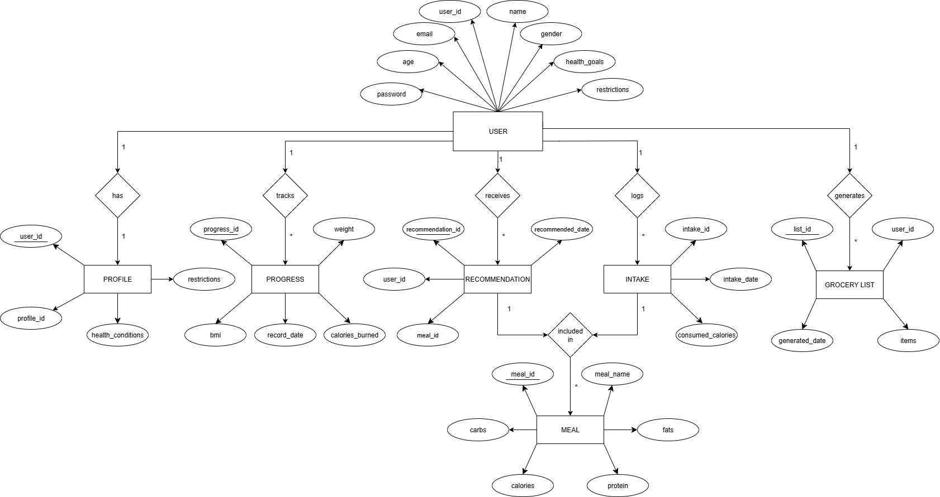
ER DIAGRAM

Slide 30
THANK YOU

